Slide 1
Sliding-Window based Stock price forecasting expert system using LSSVR
Team members
2015103519 Naveen kumar M Project Guide
2015103527 Rohith kumar K Dr.Angelin Gladston
2015103613 Umapathi C Assistant Professor

Slide 2
INTRODUCTION
Financial markets are highly volatile and generate huge amounts of data daily.
It is the most popular financial market instrument and its value changes quickly.
Stock prices are predicted to determine the future value of companies stock or other financial instruments that are marketed on financial exchanges.
However the stock market is influenced by many factors such as political events economic Conditions and traders expectation.

Slide 3
OBJECTIVES
The main objective of this project is to achieving the best accuracy in predicting the stock prices
Predicting the stock market involves predicting the closing prices of a company’s Stock for any given number of days ahead.
There are lot of available applications to predict the future stock values.But their prediction accuracy is the question.
Here we are going to follow a new approach which can give the best accuracy.
Our System will automatically fetch a real time stock data through online.

Slide 4
LITERATURE SURVEY
TITLE | AUTHOR | YEAR | DESCRIPTION
Nature-inspired metaheuristic optimization in least squares support vector regression for obtaining bridge scour information | J.-S. Chou, A.-D. Pham | 2017 | This article puts forward a revised reliability analy- sis based on SVM, namely LSSVR-MCS method
Hybrid nonlinear adaptive scheme for stock market prediction using feedback FLANN and factor analysis | . M. Anish,B. Majhi | 2016 | A feedback type of the functional link artificial neural network (FFLANN) with recursive least square (RLS) training is proposed as a potential prediction model
Efficient stock price prediction using a self evolving recurrent neuro-fuzzy inference system optimized through a modified differential harmony search technique | R. Dash and P. Dash | 2016 | The novelty of the model is based on the fact that the internal temporal feedback loops and time delayed output feedback loops are used for further enhancing the prediction capability of traditional neuro-fuzzy system in handling more dynamic financial time series data
Secondary factor induced stock index time-series prediction using self-adaptive interval type-2 fuzzy sets | D. Bhattacharya, A. Konar, and P. Das | 2016 | Employing a new strategy to induce the main factor time-series prediction by its secondary factors

Slide 5
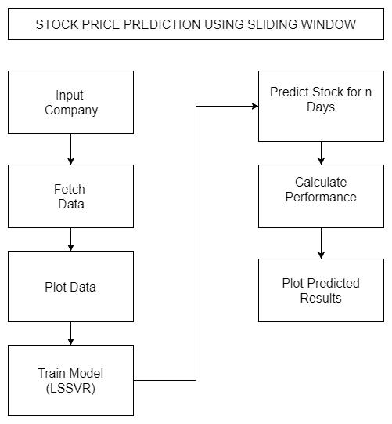
BLOCK DIAGRAM

Slide 6
DETAILS OF MODULES
Phase Space Reconstruction
In time series prediction, the time series are typically expanded into three or h Higher dimensional space to exploit the information that is implicit in them.
Selecting a suitable pairing of embedding dimension m (lag) and time delay τ is very important for phase space reconstruction.
Consider a time series x={x1,x2,x3…xn}.The time-delay vectors can be reconstructed as follows, where X is the input matrix and Y is the corresponding output matrix.
The output of the analysis is fed back to the input and future values are predicted from previous values in the time series.

Slide 7
Sliding-window method
The forecast horizon is 1. In the first validation, the working window includes p historical observations (𝑥1,𝑥2,𝑥3, …𝑥𝑝) which are used to forecast the next value 𝑥𝑝+1.
In the second validation, the oldest value 𝑥1 is removed from the window and the latest value𝑥𝑝+1 is added, keeping the length of the sliding window constant at p.
The next forecast value will be 𝑥𝑝+2.
The window continues to slide until the end of the dataset is reached. If the number of observations is N, then the total number of validations is (N-p).

Slide 8
Least Squares Support Vector Regression
The LSSVR approach is a well-developed ML technique with many advanced features that support a high generalization capacity and fast computation.
The LSSVR training process entails the use of a least squares cost function to obtain a linear set of equations in a dual space to minimize the computational cost
Accordingly, iterative methods, such as the conjugate gradient method are typically used to derive a solution by efficiently solving a set of linear equations.
To reduce the computational burden of the LSSVR for function estimation, the regression model in this study uses a quadratic loss function.
The LSSVR involves equality instead of inequality constraints and works with a least squares objective function.

Slide 9
PERFORMANCE MEASURES
The performance metrics that were used to assess the predictive accuracy of the proposed system included the RMSE, the MAE, the MAPE, the MSE, the correlation coefﬁcient (R), the nonlinear regression multiple correlation coefﬁcient (R2),and the synthesis index (SI).
These indexes are used to measure whether the predicted values are close to the actual values.
The SI ranges from 0 to 1 and an SI value of close to 0 indicates a highly accurate predictive model.

Slide 10
DATASET
Historicaily prices were taken from Yahoo! Finance, apublicly accessible website, as they were by Six years (October 5, 2011 to May 31, 2017) of daily data on five company stocks were downloaded from Yahoo! Finance.
The data were closing stock prices.

Slide 11
REFERENCES
C. M. Anish and B. Majhi “Hybrid nonlinear adaptive scheme for stock market prediction using feedback FLANN and factor analysis” J. Korean Statist. Soc. 2016.
R. Dash and P. Dash “Efficient stock price prediction using a self evolving recurrent neuro-fuzzy inference system optimized through a modified differential harmony search technique” Expert Syst.2016.
Bhattacharya, A. Konar, and P. Das, “Secondary factor induced stock index time-series prediction using self-adaptive interval type-2 fuzzy sets” ,2016
J.-S. Chou, K.-H. Yang, J. P. Pampang, and A.-D. Pham, “Evolutionary metaheuristic intelligence to simulate tensile loads in reinforcement for geosynthetic-reinforced soil structures” , Comput. Geotechnics, 2015.
J.-S. Chou and A.-D. Pham, “Smart artificial firefly colony algorithm based support vector regression for enhanced forecasting in civil engineering”, Comput.-Aided Civil Infrastructure Eng, 2015.
D. Saini, A. Saxena, and R. C. Bansal, “Electricity price forecasting by linear regression and SVM”, in Proc. Int. Conf. Recent Adv. Innov. Eng, 2016.
J. Wang, R. Hou, C. Wang, and L. Shen, “Improved v-support vector regression model based on variable selection and brain storm optimization for stock price forecasting”, Appl. Soft Comput, 2016.

